Slide 1

Human Error Frameworks – How to think about errors
Kate MacNamee, MS

Slide 2
What is Human Error
This topic has already been covered, but as a quick reminder we are talking about:
Any action executed by one or more people leading to a deviation from intention, expectation, or desirability

Slide 3
Errors are often categorized using frameworks
Frameworks are constructs - convenient ways to attempt to organize complex information
In numerous cases, frameworks may need to be adjust to be a true fit the issue you’re trying to solve
Some frameworks assess the error in a limited system (e.g., human and device)
Others asses the errors within a broader systemic context
Different frameworks may be more appropriate than others, depending on the why and how you intend to use them
Notes:
Use the notes as needed for talking points or notes for students to consider

Slide 4
Some frameworks delineate between errors and violations
Error
Unintended action or decision
Violation
Deliberate deviation from rule or procedure
Psychologists and good designers would suggest that violations also fall into the category of error

Slide 5
Some frameworks delineate between errors and violations
Human
Failure
Error
Violation
Skill
based
Rule
based
Knowledge based
Routine
Situational
Exceptional
Optimizing
Individual
Diagram adapted from DO - 10.21125/inted.2016.0391

Slide 6
Some frameworks start with intent (this can manifest in problematic ways)
Diagram developed by
TUV Rheinland/Ristek
Human
Failure
Intended outcome/action
Unintended outcome/action
Violation
Mistake
Lapse
Slip
We knowingly
break from
the rules
Believe we have done the right
thing, but are
wrong
We forget to do
Something; our memory fails
We do the wrong thing by accident; our attention fails
Notes:
Dotted line indicates the group of concepts that are “basic error types”

Slide 7
Some frameworks start with intent (cont.)
Be starting with intention, it implicitly suggests user responsibility
Do we need to design systems to guard against misuse?
YES
It favors systems that assumes the “happy path” is the right path
We can call this development arrogance
The ideal workflows in a vacuum vs in a system may be completely different
Notes:
Use the notes as needed for talking points or notes for students to consider

Slide 8
Broadly speaking…
Whether intended or not, errors and violations are often the result of suboptimal design
We can’t design a better human, so why focus on intention?
We may be better off focusing on how people already function and design our systems around that
Notes:
Not because people are special and delicate and need to be catered to, but because it’s literally the path of least resistance

Slide 9
This model serves as a hybrid between intention and goal-based frameworks
Human
Failure
Unintentional
Deliberate
Execution
Error
Cognition
Error
Rule
based mistake
Knowledge
based mistake
Deliberate
deviations from
the process
Slip
(attention)
Lapse
(memory)
Diagram adapted from: https://www.dpadvantage.co.uk/2019/06/12/human-data-errors/

Slide 10
Some flavors attempt to reframe intention and goal-aligned vs goal-opposed
Planning/Thinking errors
Typically unintentional
Users misunderstood the higher-level concept or the context in which they were working
Assumes error is often unnoticed unless consequences arise
Execution errors
Typically unintentional
Often noticed or noticeable
Typically assumes the individual knew (or should have known) the right thing to do, but did not manage to do it.
Notes:
Use the notes as needed for talking points or notes for students to consider

Slide 11
Still other frameworks start to split out top-down and bottom-up or two-way use issues
Execution failures
Planning failures
Knowledge
-based
Slips
Lapse
Rule-based
Attention:
- Reversal
- Misordering
- Mistiming
- Interference
- Double capture
- Misperception
Memory:
- Omission
- Repetitions
- Reduced intenti-onality
Rule application:
- Applied good
rule to wrong
context
- Applied bad
rule
Cognitive biases:
- Confirmation bias
- Anchoring
- Selectivity
- Vagabonding
- Encystment
Diagram adapted from: https://www.skybrary.aero/articles/human-error-types

Slide 12
A common framework in Usability/UX/HFE is the Perception-Cognition-Action model
Focuses on the full range of the human side of Human-system interface
Does not inherently account for intent
Helps development teams and designers understand where to focus fixes to reduce risk of harm
Notes:
Use the notes as needed for talking points or notes for students to consider

Slide 13
Semi-detailed PCA model (manufacturing example)
Human Error
Perception
Cognition
Action
Omissions
Types and
quantities
States
Motion
Wrong
amount
Wrong amount
of repetitions
Incorrect
selection
Incorrect
detection
Incorrect
holding
Unstable
fixation
Inverted order
Incorrect
count
Error in risk
perception
Incorrection
positioning
Incorrect
adjustment
Wrong point
in time
Execution
direction
Insufficient
prevention
Task not assigned
Figure adapted from doi: 10.1016/j.procir.2016.07.080

Slide 14
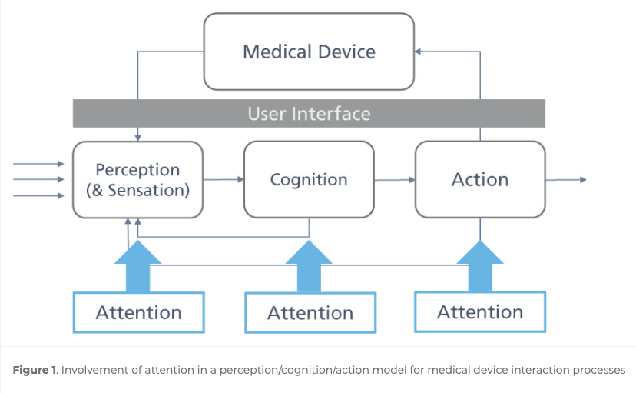
Simplified PCA model (med device example)
Diagram from MacNamee (2020) https://doi.org/10.2345/0899-8205-54.1.28

Slide 15
Examples of P, C, and A errors
Accidental button press
Action error: saw the button and knew it was there, but hit it during an unrelated, correct action
Perception/Sensation error: Didn’t see or feel the button’s presence, so engaged with it as part of an unrelated, correct action
Released syringe plunger before dose is complete
Action error: finger slipped off the plunger unintentionally
Perception error: perceived the plunger to have reached the bottom of the syringe/dose window
Cognition error: misremembered the instructions saying to push the plunger down for 6 seconds instead of 10 seconds
Notes:
Use the notes as needed for talking points or notes for students to consider

Slide 16
The reason to categorize errors in the first place is to understand why they occurred
Confusion or misunderstandings that never lead to incorrect actions aren’t of high concern
Understanding why an error occurred (i.e., identifying the root cause) allows us to better prevent that error
Notes:
Use the notes as needed for talking points or notes for students to consider

Slide 17
So, is there a “right” framework?
There’s usually an optimal choice, but the best option may change in differing contexts
Industry and users
Resources and ability to collaborate
Timeline/point in the development process
Practitioner skill level
Notes:
Use the notes as needed for talking points or notes for students to consider

Slide 18
Ensure categories allow for focused and effective “risk control measures” or “mitigations”
Helps product teams to focus on the “root cause” of the error – the ultimate reason it happened
Proper identification of root cause means better mitigation, and therefore less likely errors will occur in the future
Notes:
Use the notes as needed for talking points or notes for students to consider

Slide 19
Create or choose a framework by thinking through your context and your goals
Are there principles you believe to be true?
e.g., The user isn’t to blame
e.g., Sensation, perception, and cognition affect behavior
e.g., Attention mediates most human choices
How complex is the use environment or product ecosystem?
What job or goal do you have? Does your team have? Are all disciplines’ goals satisfied?
Notes:
Use the notes as needed for talking points or notes for students to consider

